Slide 1
Section 3: Introduction
M365 – MS 100

Slide 2
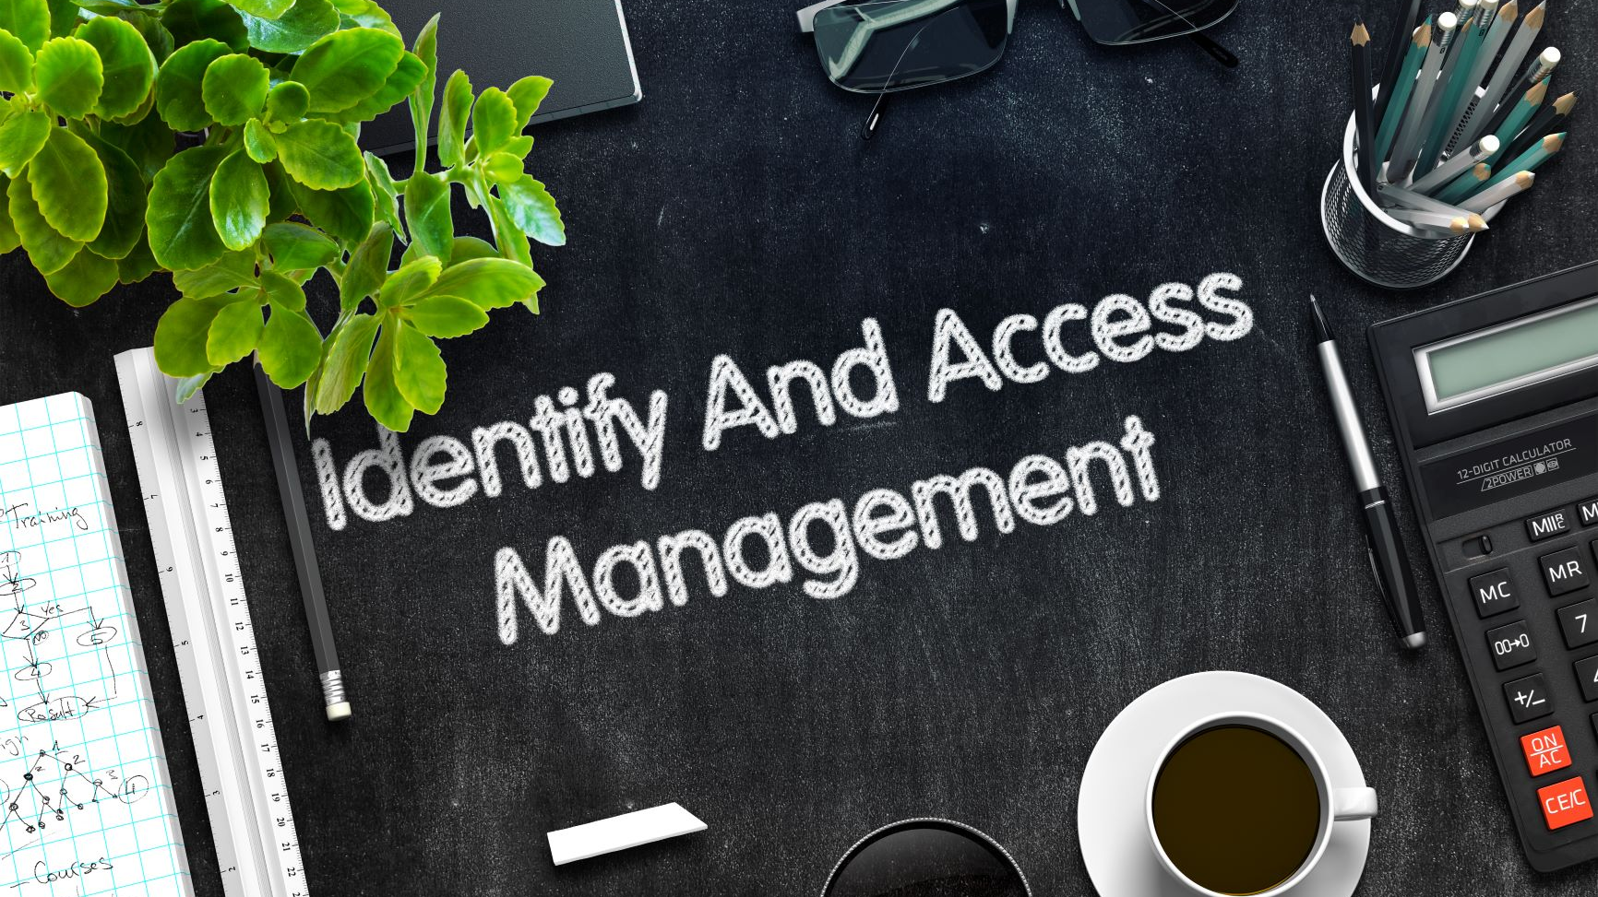

Slide 3

Remote Working Capabilities Compulsory

Slide 4

Office Network Perimeter Security is NOT enough!

Slide 5

Bring Your Own Device (BYOD) and Reduce Business Costs

Slide 6
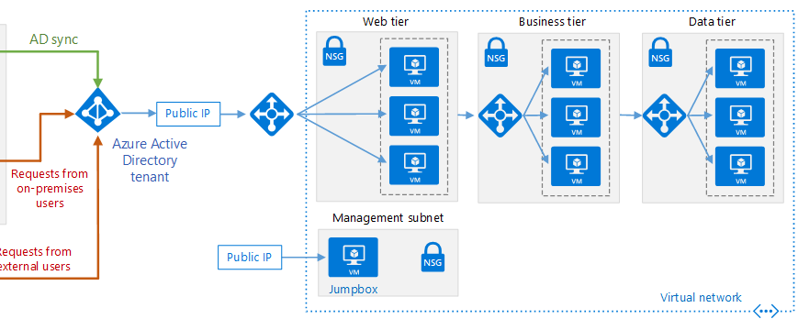
Azure Active Directory
Azure Active Directory (Azure AD) is a cloud-based multi-tenant directory and identity service

Slide 7
Topics
What is Microsoft 365 Identity and Access Management
Hybrid Identity solutions – PHS, PTA & Federated
Enables IT Teams to manage accounts from a central location
Offers common identity for accessing both cloud and on-premises resources
Plan Azure AD Connect
Install Azure AD Connect - Demo

